Slide 1
WebCenter Owner Overview

Slide 2
The WebCenter program provides a system to
Generate cash flow NOW!
Build a successful UnFranchise!
Notes:
TRAINER’S NOTES:
Our program is lucrative now and in the future, thus making an excellent opportunity for expanding distribution with qualified prospects

Slide 3
The Best WebCenter Owners have the SAME Qualities as the Best UnFranchise Owners!
The QUALITIES of the person are more important than their education, experience, technical knowledge etc.
Prospects with the following qualities are positioned to leverage our system for success
Friendly & Sociable
Well-Connected
Young Entrepreneurs
Organized & Reliable
Go Nows
Professionals (All Kinds)
Management Skills
UFO Prospects
Notes:
TRAINER’S NOTES:
When identifying great WCO candidates, it’s important to focus on the “kind of person” the prospect is rather than their just their profession
Techies are not bad candidates. They simply aren’t the ONLY candidates
A waitress who is a go getter/ motivated individual is a better WCO candidate than a lazy web designer

Slide 4
Profitability What is the potential behind the opportunity?
The Product & Service Is this a product/service that I like and is there a market for it?
The System How does the system work
Support What kind of support is available to help my business grow
It’s important to explore all of the areas and make an educated decision to go into business for yourself, but not by yourself.
How to Get Started What are my options to get going?
Notes:
TRAINER’S NOTES:
Self Explanatory

Slide 5
Let’s take a look at earning potential
Retail Profit
BV
Growth Potential
Notes:
TRAINER’S NOTES:
Earning potential will be demonstrated in terms of short term and long term growth potential

Slide 6
Think about the different fixed-cost goals you have:
Pay for your travel expenses for the year | Family Vacation
Put your business in the black | Pay off credit cards
Help a prospect earn the money to get started | Holiday Shopping
 | Extracurricular Activities
 | Buy a new toy
Business Goals
Family / Personal Goals
Notes:
TRAINER’S NOTES:
Business owners have two types of expenses.
Feel free to verbalize seasonal things. For example – if it’s summertime, talk about summer camp costs. Share your own expenses that come up etc.
It’s important to talk about how all of these goals are FIXED COST ITEMS that can be paid off

Slide 7
The average website sale is NT $41,600
That generates about
NT $32,000 retail profit!
Take your goals, break them down into NT $32,000 increments to get an estimate of how many website sales you’d need to make to achieve those goals
Notes:
TRAINER’S NOTES:
Again – you can apply this to any of your fixed cost goals

Slide 8
Each website sold
generates 230 BV
Each active client
generates
30 BV / Month
Now you can earn
additional BV on
Design!
Notes:
TRAINER’S NOTES:
Again – you can apply this to any of your fixed cost goals

Slide 9
The WebCenter Program is an excellent way to grow your entire business.
It’s not just about sales, there are a number of ways you can expand your business to be more profitable in the long term.
In this industry, it’s not just about you and what you can do.
A major goal is to duplicate the system and expand your business and network.
We will cover more on the system for duplication in a bit, but let’s first talk about the different ways you can expand your UnFranchise with the WebCenter Program
Internship Program
Building Share of Customer
EMP
Notes:
TRAINER’S NOTES:
This is where we talk about growth potential. It’s not just about what the UFO can achieve on their own – let’s show them the opportunities they have to build further!
Prospecting / Recruiting
Building share of customer
Global expansion

Slide 10
You can offer a competitive internship program for up to 4 interns at a time. This program provides a way for potential WebCenter Owners to leverage their sweat equity and be coached by you, an experienced WebCenter Owner.
Intern’s have unlimited access to sales support to conduct website sales appointments on their behalf
Setting up a WebCenter intern is EASY.
Notes:
Trainers Notes
Duplication is critical and there are a number of ways for you to duplicate the power of the WebCenter Program in your organization, one of which is via Internship.

Slide 11
E
A
S
Y
Explain the business to your intern. The goal is for them to become a qualified business partner, so their understanding of the business is critical.
Activate status as an intern. You can have up to 4 interns at a time. To create an intern, create a contact in your WebCenter and label it “WebCenter Prospect”.
Sell websites and earn retail profit. By leveraging the simple sales system and product specialist, you help your intern to sell 1-2 websites.
You help your intern to capitalize their UnFranchise with retail profit from website sales. Retail profit is paid to you, the WebCenter Owner. You MUST use the profit to capitalize your intern’s business
Notes:
Trainers Notes
Briefly describe the process. Encourage prospects to check out mawc411.com for more information

Slide 12
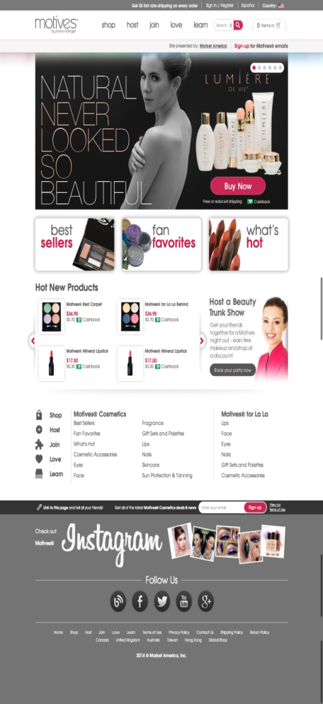
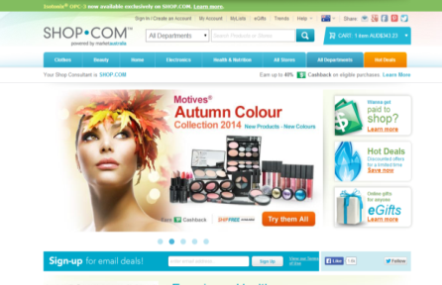
Our Customers are Small Business Owners
Help business owners with their overhead / expenses
Build share of customer with other ma products
SMB Owners = Entrepreneurs / UFO Prospects
Notes:
Trainers Notes
Excellent way to expand your network
Opportunities to build share of customer with your website clients

Slide 13
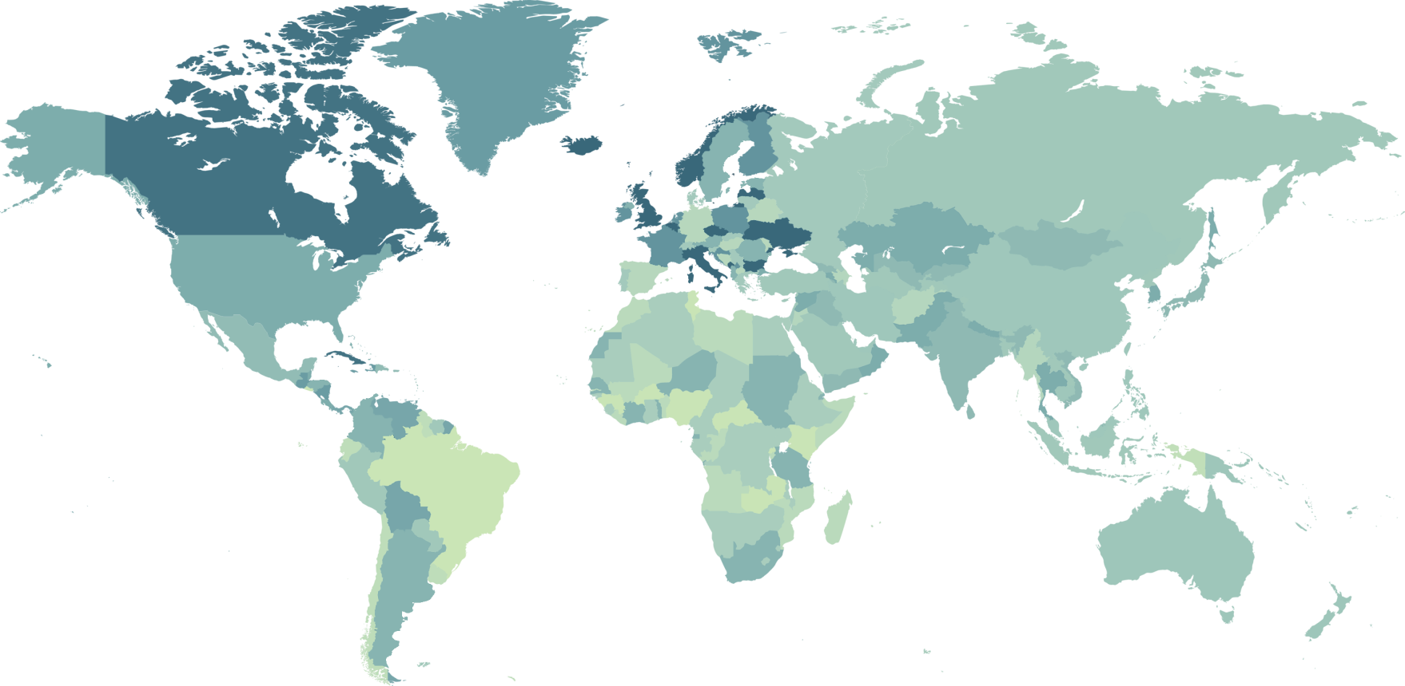
Market Countries
USA
Canada
Mexico
Australia
Taiwan
Hong Kong
United Kingdom
Spain
Singapore
EMP Countries
Bahamas
Costa Rica
Columbia
Dominican Republic
Ecuador
Jamaica
New Zealand
Your Global WebCenter
Your WebCenter is automatically enabled to sell websites globally in all Market Countries & EMP Countries!
Notes:
TRAINER’S NOTES:
What does that do for us?
First, by having websites which are completely in other languages and the entire back end of the system, including the menus and contextual help, the business owners who are more comfortable with another language will be able to take more effective use of the solution.
Second, by providing all the support, from sales to ongoing support with clients, all in multi-languages.
As a non-native speaker, you can probably find numerous business owners who you can have a short conversation to set an appointment with, but you wouldn’t be able to do a sales walkthrough because the business owner might not understand English well enough. This way, all you need to do is set the appointment, and let the team handle the rest for you!
And we all know that some of your best business prospects are business owners and customers of yours. This is a very natural way to lead to prospects for the business in a cultural market you might not have thought you could make inroads to.

Slide 14
Absolutely!
High Retail Profit Potential
Residual BV
Duplication
Share of Customer
Global Expansion / EMP
Is this a profitable
opportunity?
Notes:
TRAINER’S NOTES:
Take a minute to just hit the points really fast. This is an impact slide to show that the profitability of our model is high! The potential is big and they have many opportunities to be successful.

Slide 15
When evaluating the product & service, some good questions to answer are:
Is there a market for the product/service?
Is this a product/service I like?
Is the product/service competitive in the market
Notes:
TRAINER’S NOTES:
Here are some talking points:
We are all consumers of websites in our every day lives. Think about where you read your news, socialize etc.
Would you agree that people are plugged in and get much of their information online?
Businesses need to be online so they can interact with their customers and potential customers
Customers have an expectation to be able to browse websites for products, information and services

Slide 16
Where do you
Get your news
Socialize
Research
Find products
Find services
Play
Get Music
Get Books
Get Periodicals
Get Advice
The internet connects the world! Everyone is “Plugged in”.
If you think about it, we are all consumers of the internet in some way, shape or form!
Notes:
TRAINER’S NOTES:
Here are some talking points:
We are all consumers of websites in our every day lives. Think about where you read your news, socialize etc.
Would you agree that people are plugged in and get much of their information online?
Businesses need to be online so they can interact with their customers and potential customers
Customers have an expectation to be able to browse websites for products, information and services

Slide 17
We are a partnership
Market America,
MaWebCenters
& you
Notes:
TRAINER’S NOTES:
Remember, it’s a strategic partnership. We are all in business for ourselves, but not by ourselves. You partner with two powerful companies as part of your business model, Market America which provides logistical and business development support and maWebCenters who provides the technology support and customer service
Many companies these days rely on strategic partnerships to become stronger and have better longevity and success, you are doing the same thing but within
Together we are helping small- medium sized businesses grow their business while simultaneously growing our own.

Slide 18
We can help SMB (Small-Medium Sized Business) with:
Increasing Revenues
Decreasing Expenses
Increasing Customer Satisfaction
Participating in the most popular and effective way to gain new business!

Slide 19
What Makes Us Different
Our clients are getting more than just a website, they are getting an entire online marketing strategy.
Let’s take a look at the myriad of tools and options that our clients have.
Notes:
TRAINER’S NOTES:
Introduce the concept of online marketing strategy verses just a website

Slide 20
Responsive Websites
Website Development
Completely customizable
Easy to edit / Drag & drop tools
Business owner has control
Edits are published immediately
Free mobile websites
Notes:
TRAINER’S NOTES:
Here are some talking points:
We are all consumers of websites in our every day lives. Think about where you read your news, socialize etc.
Would you agree that people are plugged in and get much of their information online?
Businesses need to be online so they can interact with their customers and potential customers
Customers have an expectation to be able to browse websites for products, information and services

Slide 21
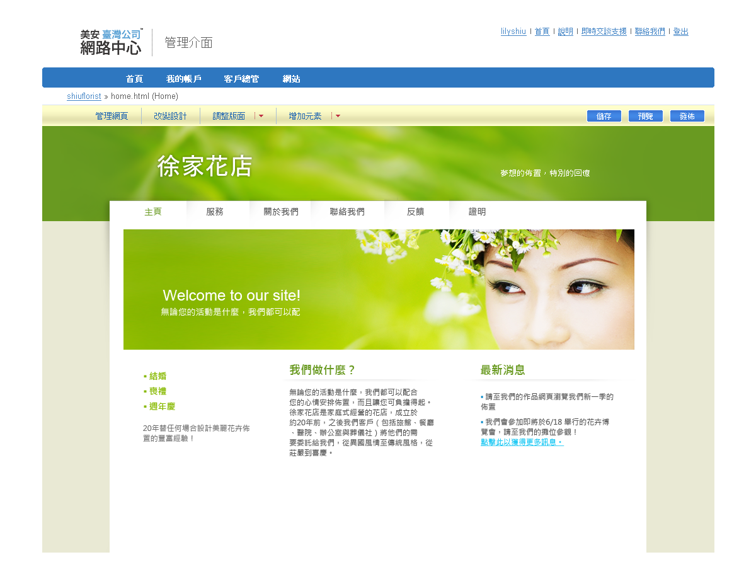
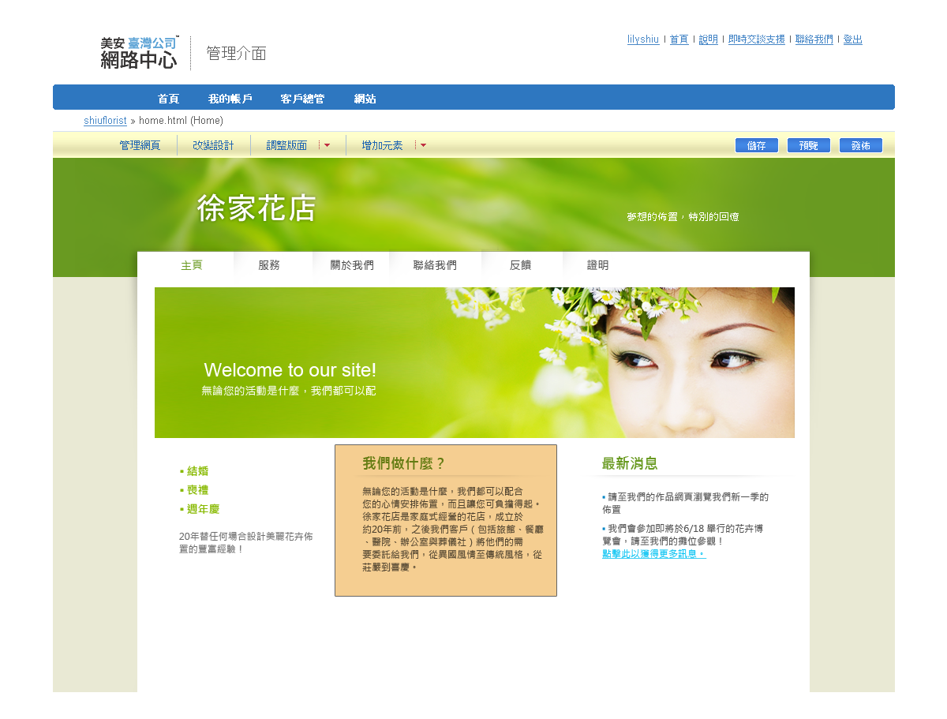
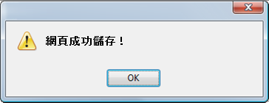
Easy Content Management Edit text
我們有什麼？
各種設計師方案,快遞服務,您的選擇方案

Slide 22
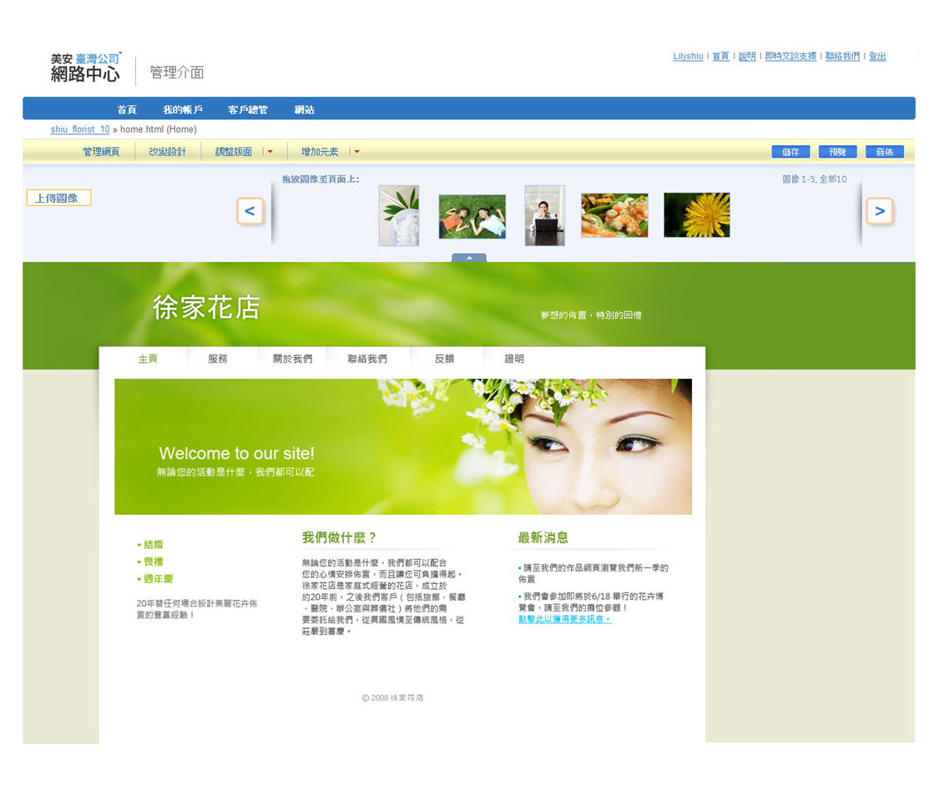
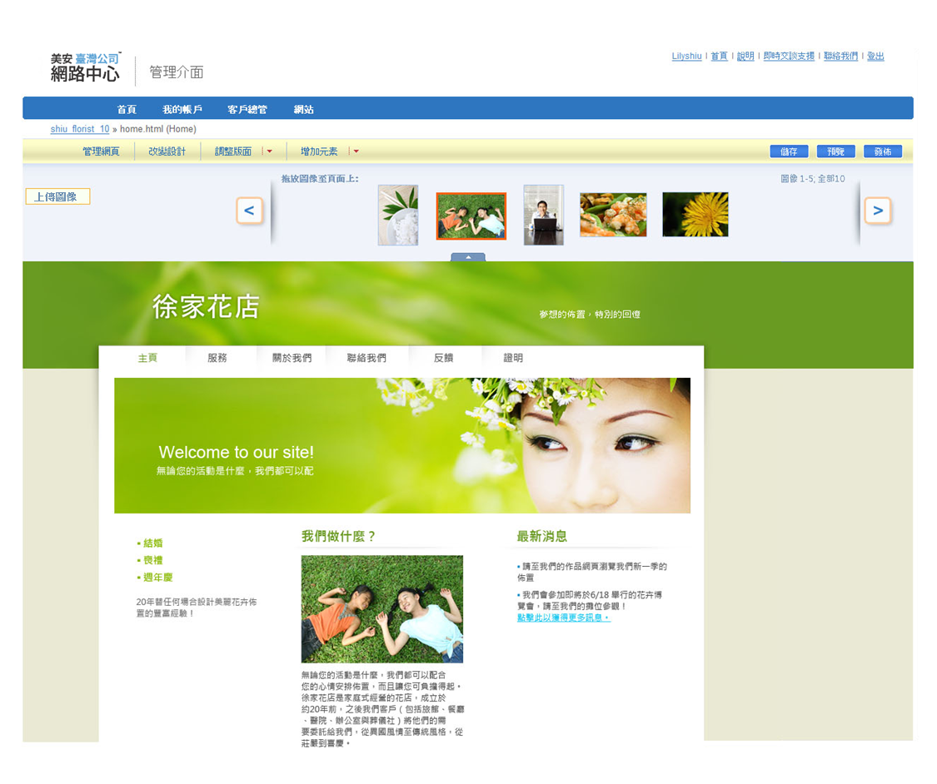
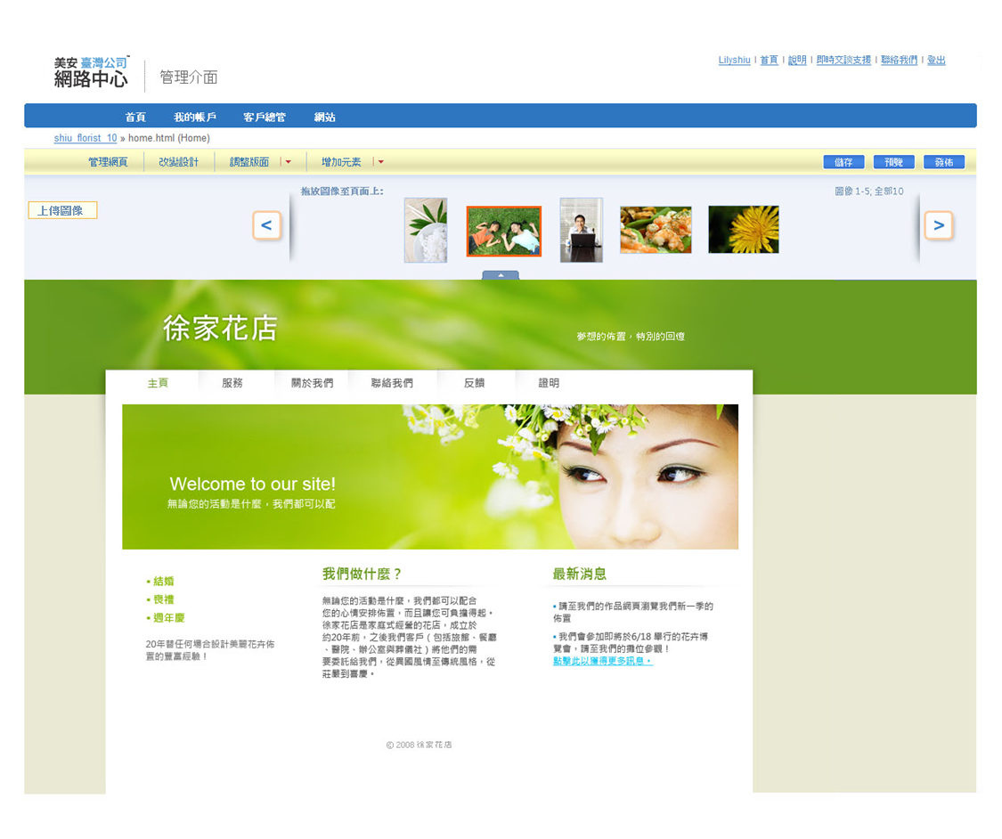
Easy Content Management ADD IMAGES

Slide 23
One of the options your client will have is to use our design team. Our team of professional designers can provide your client with a dynamic customized website, fully integrated with our entire solution. Learn more about the design center at: http://www.mawc411.com/designcenter.jsp
Website Design
Notes:
Trainers Notes: Self Explanatory

Slide 24
設計中心
Design Center
Notes:
講師筆記:
這是我們設計中心的範本
你可以看到我們的設計非常專業
任何業主都會喜歡這些設計使用在他們的網站上
我們都會在臉書上分享最新的設計: facebook.com/officialmawebcenters

Slide 26
eCommerce Tools
Configurable product with options that adjust the sales price
Pan and zoom product image
Order history with easy “Reorder” feature
Multiple billing options
Shopper wish list
Compare products
Shopper product reviews
Product tags
Sales dashboard
See who’s shopping
Enhanced Product Catalog search results with product thumbnails

Slide 27
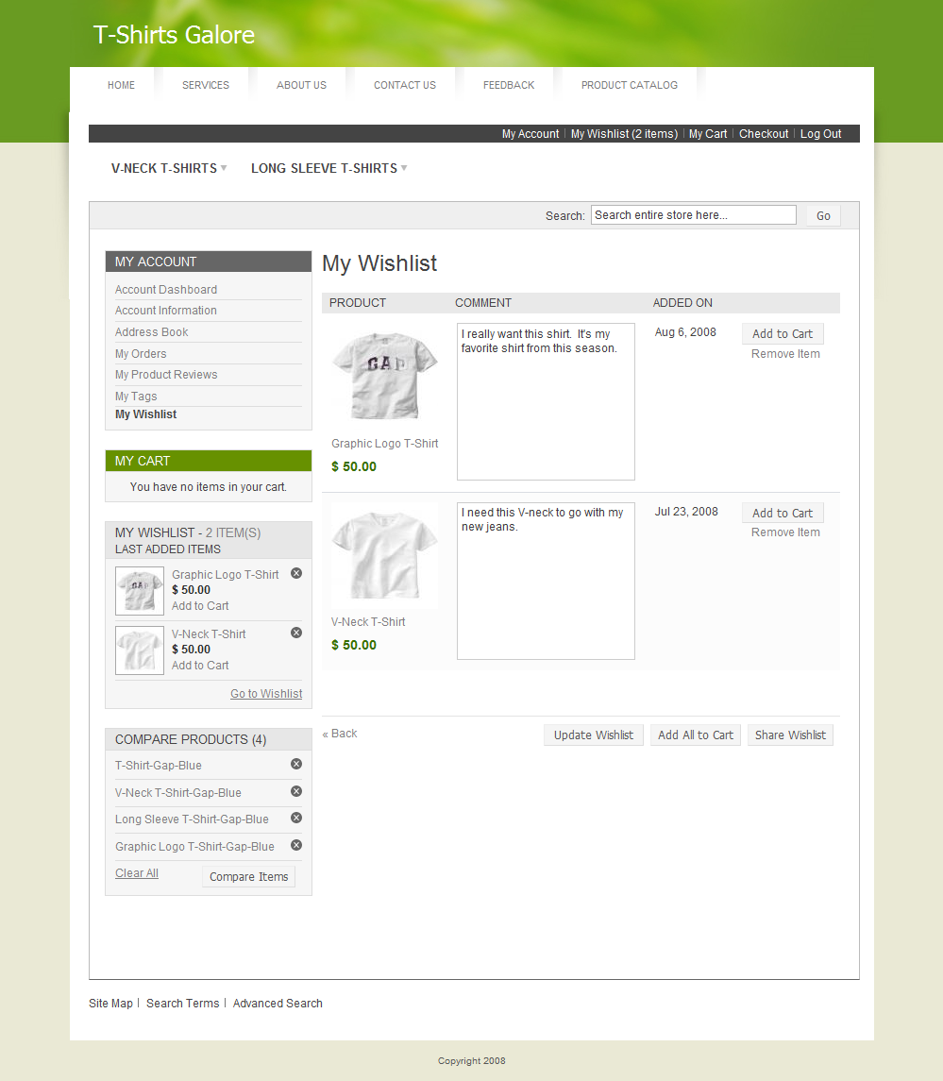
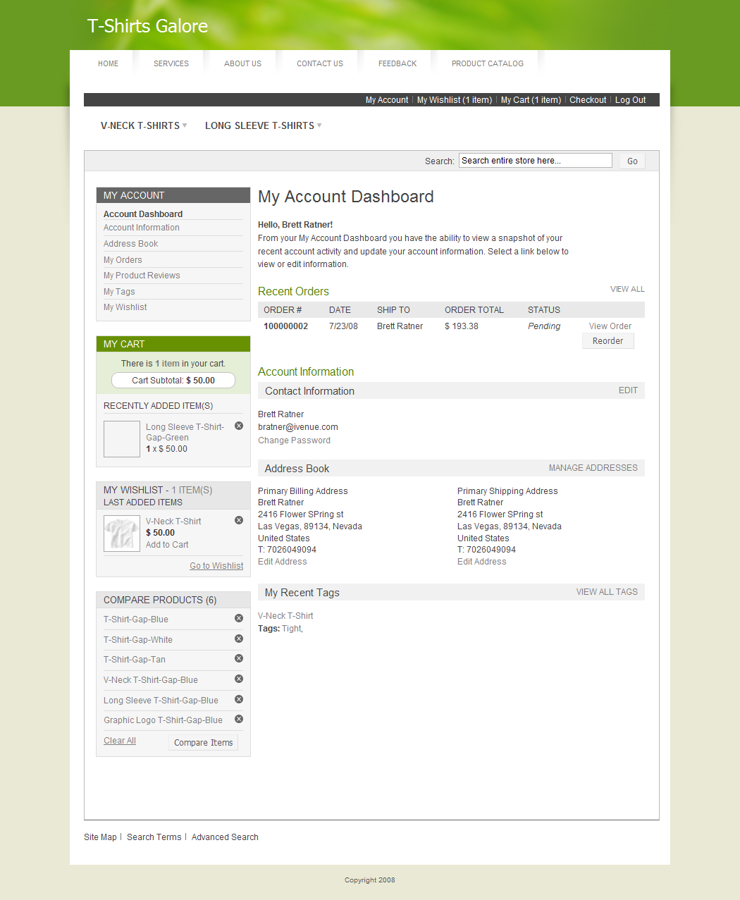
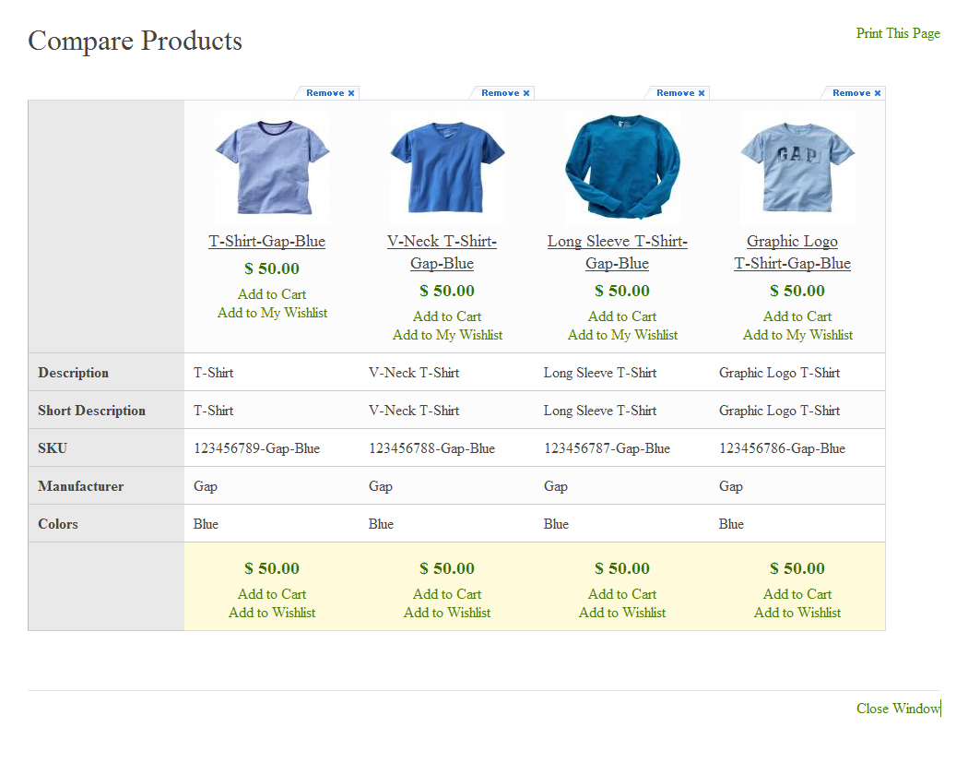
Shopper Account
Compare Products
Notes:
TRAINER’S NOTES:
Our e-commerce system is incredibly flexible.
There is so much which can be done with it.
(share some personal examples from your own client base).
(hit some of the highlights from the F&B).
Again, this is about providing an effective Internet presence. If the business owner’s current solution doesn’t allow for customer reviews or wishlists, is it an effective internet presence? Nope!

Slide 28
Marketing
Tools
SEO tools
Social media tools
CRM
Email marketing
Domains
Email
Mobile websites
Notes:
Trainers Notes:
This is just an intro slide – The goal here is to get them excited about what we are going to talk about.
In brief, cover the big topics “Websites, Marketing Tools, Unlimited, Support, Security)
The goal is to paint a simple picture of how all –inclusive our solution actually is / Instill confidence in the product.
Spend 1 minute or less on this slide – the details are coming up!

Slide 29
The Power of Unlimited
Unlimited Pages
Unlimited Changes
Unlimited Traffic
Unlimited E-mail Address
Unlimited Upgrades
With unlimited support, changes and upgrades, having an effective online presence is simple.
We take away the challenges that business owners face to stay current with their online marketing solution.
Notes:
Trainers Notes:
This is just an intro slide – The goal here is to get them excited about what we are going to talk about.
In brief, cover the big topics “Websites, Marketing Tools, Unlimited, Support, Security)
The goal is to paint a simple picture of how all –inclusive our solution actually is / Instill confidence in the product.
Spend 1 minute or less on this slide – the details are coming up!

Slide 30
Take a look at some
recent free upgrades
Notes:
Trainers Notes:
This is just an intro slide – The goal here is to get them excited about what we are going to talk about.

Slide 31
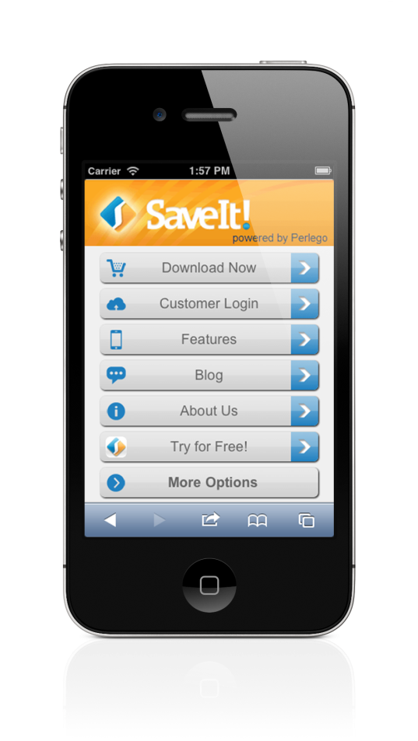
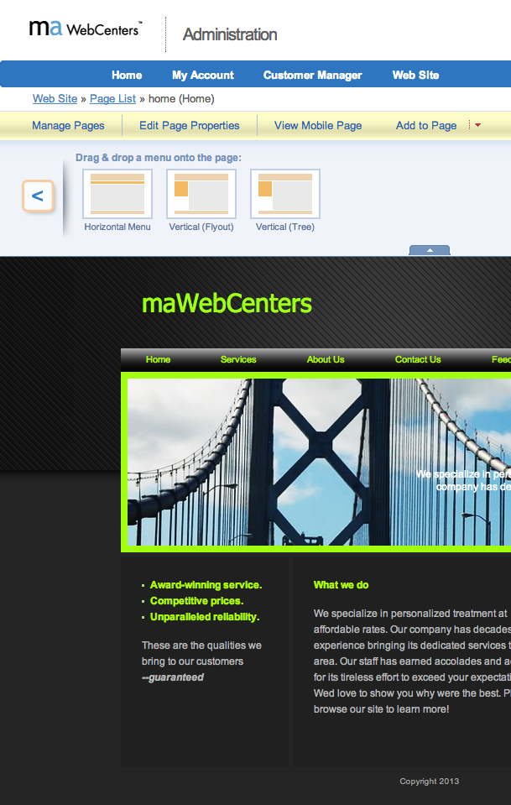
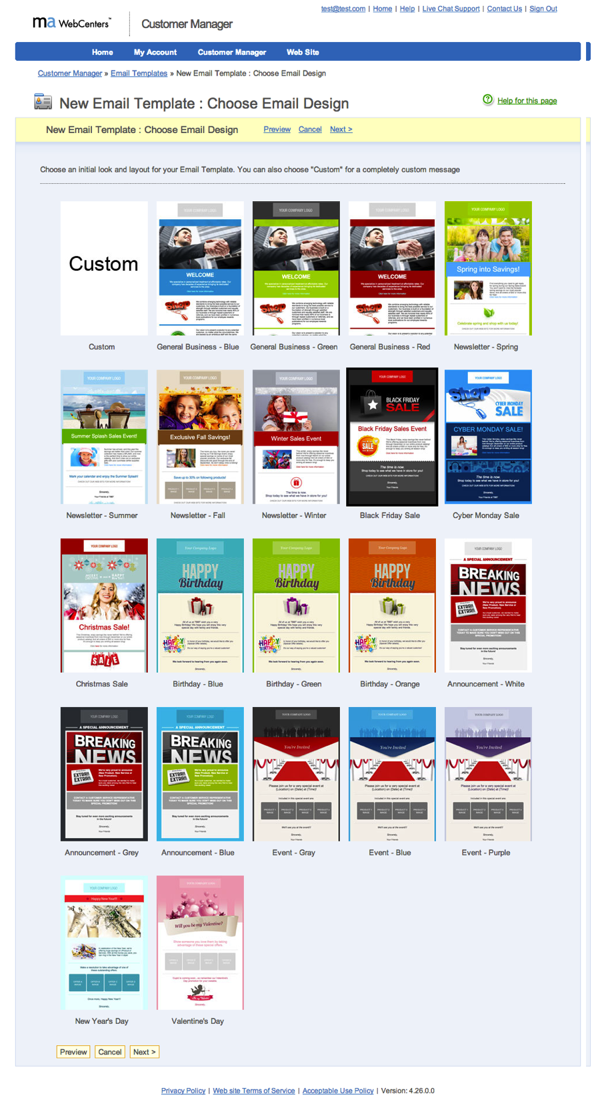
Free Mobile
Websites!
Brand New Email
Marketing System!
New Widgets! i.e.: Menu as a widget
Notes:
Trainers Notes:
Always upgrading. These are recent but more are on their way!

Slide 32
Support & Security
Award Winning Unlimited Customer Care
Unlimited help editing the site
Support using all features & tools in our solution
Home country, 24/7 support
Ultra-secure hosting facility 24x7 Security and incident monitoring, hosted on tiered, high performance Dell PowerEdge servers, protected from fire, floods, earthquakes, power outages, and other types of disasters
Dual-layer firewall protection Using Cisco PIX firewalls
Notes:
Trainers Notes:
Share Stories!

Slide 33
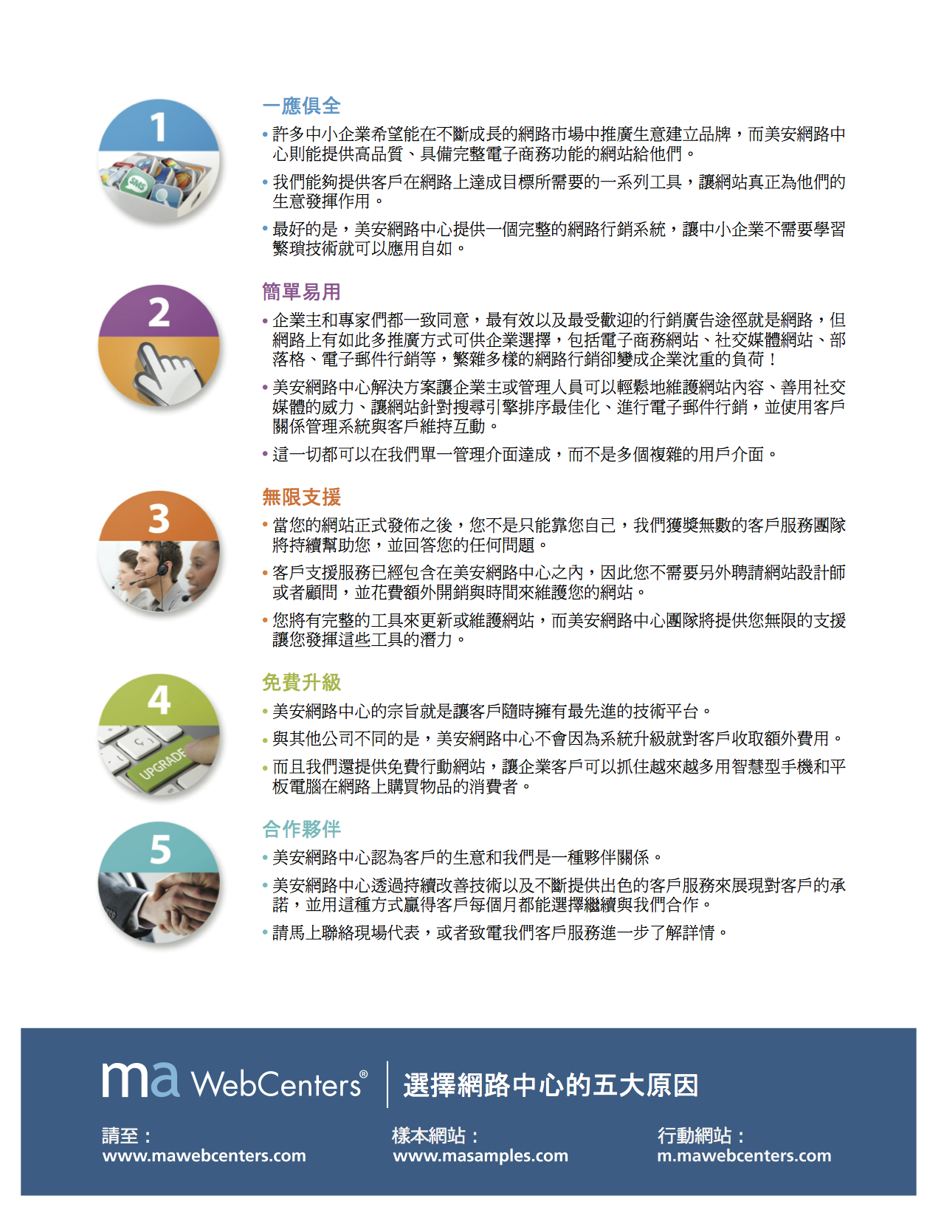
Notes:
Trainers Notes: This is a simple piece that provide some key talking points to share with a potential client. It’s a great leave behind with a client and/or introductory piece to share. It’s highlights 5 reasons why we are better! You can download this on www.mawc411.com

Slide 34
We’ve established
We have an incredible product that is a profitable investment for your client!
There is solid earning and growth potential for you, the WebCenter Owner
Now let’s learn about the system behind the product and potential!
Notes:
Trainers Notes:
Again – another Impact Slide! Just a reminder – “We have an awesome product and there is a market place for what we are selling”.
Now we transition into the next point of evaluation – “the system”

Slide 35
So, What are we selling?
The WCT 101 and 201 classes cover our system for sales in depth.
What we want to cover now are the fundamental blocks that make up our sales system.
Websites?
Marketing Tools?
Both?
Notes:
Trainers Notes:
Remind people that we are going through the fundamentals of our sales system and that they can get more training about our standardized system for sales by attending a 101 or 201 course. It’s also a good point to mention where they can find out where these trainings are (www.mawc411.com) and feel free to let them know if you have any upcoming trainings

Slide 36
We Sell The Appointment!
Notes:
TRAINER’S NOTES:
Let’s talk about what we are selling.
Are we selling…
The technology?
The features?
The benefits?
The appointment?
Which do you think and why?

Slide 37
Our system is built on selling appointments and then leveraging our teams of professionals to handle all of the heavy lifting for you while providing the best possible product / service to your client
Notes:
TRAINER’S NOTES:
You are not the sales, design or technical expert
There are professional teams that work for you who will do this heavy lifting for you

Slide 38
Teams of Professionals include:
Product Specialists
Design Center
Customer Care
Notes:
TRAINER’S NOTES:
You are not the sales, design or technical expert
There are professional teams that work for you who will do this heavy lifting for you

Slide 39
Product Specialists Will:
Read your notes in the scheduled appointment / chat with you about the notes 5 minutes before the appointment.
Ask your prospects questions about their business
Demonstrate our technology to your prospect
Answer your prospect’s questions
Follow Up with your prospect for you!
Sell the website for you!
The interactive Sales Support Calendarallows you to schedule an appointment with one of our qualified website sales experts who will conduct sales appointments for you
Notes:
TRAINER’S NOTES:
Help your class understand that product specialists are easy to use and that they will help make them money
Let them know what they can expect from the product specialist so they will feel more comfortable using them

Slide 40
DESIGN CENTER
Once a Design Center package is sold, the client who purchased it is contacted by phone within 2 business days by the project manager associated with their project to get the ball rolling.
From that point on, it’s just a matter of getting the information, documents, pictures, and authorizations, to keep the project moving forward.
Phases: Conceptual, Integration, Launch!
Our team does an excellent job of making sure these projects move forward and the clients are happy!
Notes:
TRAINER’S NOTES:
Help your class understand that design center are easy to use and that they will help make them money
Let them know what they can expect from the design center so they will feel more comfortable using them

Slide 41
What about ongoing
Support for your clients?
Customer Care:
Group of trained professionals who will assist your clients with support maintaining their websites and using our tools!
Clients have unlimited, 24/7 access to the team!
Clients can request to work with preferred support technicians!
You have access to this team as well!
They are a huge part of the service we provide, so make sure to promote them!
Notes:
TRAINER’S NOTES:
Makes our system duplicatable because you don’t have to be a technical guru to maintain your client’s websites.

Slide 42
You schedule an appointment with a website prospect
Sales Support helps to sell the website for you
Design Center can design the site for your customer
Customer Care will help maintain the site for your customer and provide support for all of our marketing tools
Notes:
TRAINER’S NOTES:
Simple Sales Recap
Keep it simple!
Leverage the teams of professionals to do all the heavy lifting for you
You can give tips for being a customer manager – what do you do with your clients? - Call to see how the appointment went - Make sure your clients have accurate contact information for tech support - Check in every once in a while

Slide 43
Think about all the business owners you already know!
Where are some of the places you do business with?
“Hey Joanne! This is Sue, I’m a huge fan of your restaurant. Listen, I was going to share your website with a friend but couldn’t find it. Do you have a website? Oh really? Well…”
Ex: Your favorite restaurant.
It’s as simple as making a phone call or walking in and asking a few questions.
Notes:
TRAINER’S NOTES:
Sometimes it helps to already know if your prospect has a website.
If you are already prepared with this information, it can help you to form some good questions and conversation starters
The goal here is not to use this information to solicit your prospects but rather to use it to engage prospects in conversation.
This is also a great way to qualify if there is any existing advertising budget

Slide 44
Now here’s the magic part where you simply edify the teams of professionals and Set The Appointment
“You know Joanne, I work with a great company that has an entire division that specializes in helping small businesses leverage the internet. If you’d like, I could get you an appointment with one of the product specialists to see if they may be able to help you out with that!.”
It’s that simple.
Sell the appointment. Leverage the teams.
Notes:
TRAINER’S NOTES:
Your answer to “what is it” is basically you making a solid referral and edifying the product specialists
Think of how you would invite someone to see the plan if you were a brand new distributor – you would edify the speaker and possible solution.

Slide 45
The WCT 101 & 201 Classes cover more in detail:
Goal Setting
Our Product & The Market Place
Lead Generation
How to Talk to Website Prospects
How to Leverage our Sales System
How to Expand your Business with WebCenters
How to Use Your WebCenter
Notes:
TRAINER’S NOTES:
Again – reiterating that the system for sales is covered in depth in our 101 and 201 classes

Slide 46
Your WebCenter provides you with all of the tools you need to leverage our proven system for success
All maWebCenters include:
A front-end website to market your website sales business
An interactive sales calendar to schedule appointments
Access to domains and emails, email marketing
Customer relationship management tools, search engine tools, social media tools, mobile websites and more!
Access to Sales Support, Design Center, Customer Care
Webcenters monthly fee- ntd 1440
Notes:
TRAINER’S NOTES:
Self Explanatory

Slide 47
Standardized Live Training and Online Training
WCT 101: “Succeeding with Simple Sales”
The maWebCenters Certification Course 101 is designed to give you a simple and duplicatable system for building your unFranchise as a WebCenter Owner. You will gain a foundational understanding of our product, simple sales system and business building techniques. This course also features a section on navigating your WebCenter, an action plan for success and valuable workshop moments for you to gain practical experience in the classroom.
WCT 201: “Advanced Selling & Networking”
maWebCenters 201 class is designed for WebCenter Owners who have taken the 101 course and are ready to take their business to the next level. This course features more advanced selling and business building techniques along with more advanced knowledge of the WebCenter, marketing materials and other tools. It features valuable workshops for goal revision, sales techniques and even a call workshop to set appointments while you learn.
Notes:
TRAINER’S NOTES:
Standard trainings about our proven system provide support. There is no need to figure out what to do to become successful, we lay out the proven strategies for you!

Slide 48
Webcenter Online Resources
Online WCT www.mawc411.com/online_wct.jsp
WCO Blog blog.mawc411.com
Distributor Support Website www.mawc411.com
Facebook 90 Day Support Group facebook.com/groups/WebCenterFastTrack
Webinar Series www.mawc411.com/webinars.jsp
maWebCenters Newsletter newsletter@mawebcenters.com
Notes:
TRAINER’S NOTES:
Self Explanatory

Slide 49
Webcenter Online Resources
Unlimited Access Tech Support
help@mawebcenters.com
(p) 1-866-WEB-HELP
(f)1-800-933-1050
Live Chat Support 24/7
YouTube (Distributor) www.youtube.com/user/officialmawc
Getting Started Guide www.unfranchisetraining.com
90 Day Fast Track Guide www.unfranchisetraining.com
Unlimited Access Sales Support 866-287-8121
Brochures, Product Cards, Flash Drive etc. available in your WebCenter
Notes:
TRAINER’S NOTES:
Self Explanatory

Slide 50
Become a WebCenter Owner!
Login to your UnFranchise and select "Order Products“ Enter in Code
Purchase a WebCenter
HK code:HK6040 Cost: HK$2,730
/ BV: 300
WebCenter Reactivation
HK code: HK6040RA Cost: HK$1,170 / BV: None
Notes:
TRAINER’S NOTES:
In order to implement our system, you must have a WebCenter
These are the options for existing UFOs

Slide 51
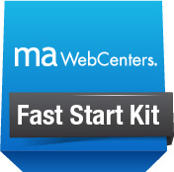
Get a New Business Partner Started! HK$3,237
Master UnFranchise Business (300 BV & 3 BDCs)
Independent UFO Subscription Kit
Business Building Materials
maWebCenter backed by maWebCenters Teams of Professionals
Notes:
TRAINER’S NOTES:
Fast Start Kit is available to prospects who want to start their UFO business as a WCO

Slide 52
Profitability Substantial retail profit & BV potential with opportunities to build in depth domestically & globally.
The Product & Service An all-inclusive, superior online marketing solution to help businesses leverage the internet & market their business
The System A simple sales system, supported by teams of professionals
Support Standardized trainings, webinars, meetons, printed materials, teams of professionals
How to Get Started Fast Start Kit, Become a WebCenter Owner, Internship
Let’s go ahead and re-ask those important questions!
Notes:
TRAINER’S NOTES:
Revisits the initial questions we wanted to answer for the person evaluating this as a business opportunity
Impact slide – hit the points hard but quickly /

Slide 53
Remember, all the knowledge in the world is useless unless You Take Action!
Check out www.mTWEBCENTERS.com
Check out the Webinars
TALK TO THE PERSON WHO INVITED YOU
Get to a WebCenter Certification Training
Become a WebCenter Owner
START YOUR JOURNEY FOR SUCCESS!
Notes:
TRAINER’S NOTES:
End on an encouraging note
Give follow up steps
Encourage them to talk to the person who invited them to check out the overview
Let them know about any upcoming events

Slide 54
THANK YOU

